Slide 1
PIPELINING
Pipelining is a technique of decomposing a sequential process into sub-operations, with each sub-process being executed in a segment that operates concurrently with all other segment.

Slide 2
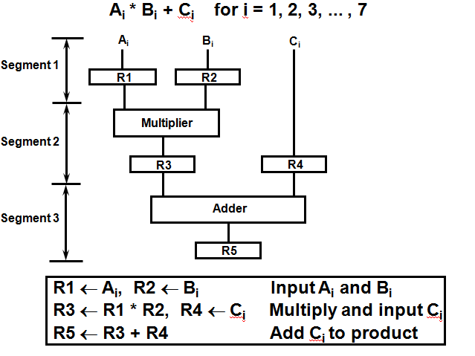
Example for Pipeline Processing

Slide 3
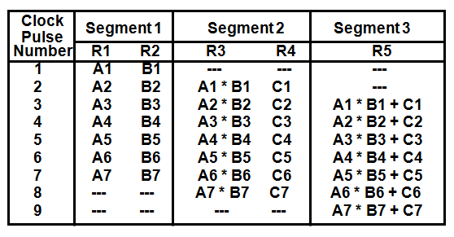
Operations in each pipeline stage

Slide 4
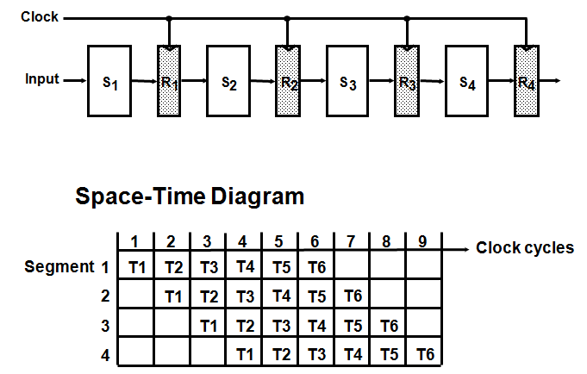
General Four-Segment Pipeline

Slide 5
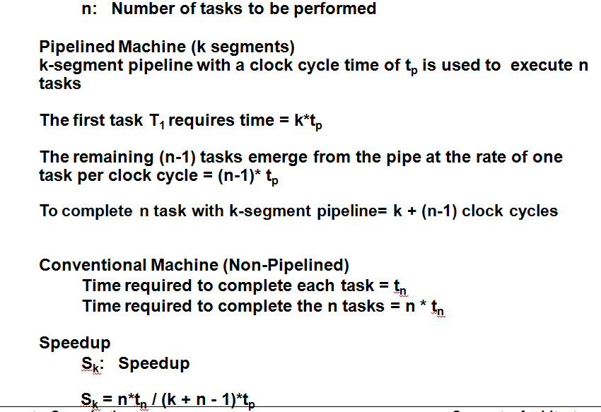
Pipeline Speedup

